Slide 1

Enabling Fast and Robust Federated Learning
Ramtin Pedarsani
University of California, Santa Barbara

Slide 2

Motivation
Local data
Learn an ML model at the edge – edge computing

Slide 3
Federated Learning
Centralized Machine Learning
Federated Learning
SGD
SGD
SGD
Learning a shared model
Privacy-sensitive content
High uplink communication
Slow training
SGD
At each device $i$
Download the current model $θ_{t}$ from PS
Using the local data update $θ_{t+1}^{i}$ (e.g. SGD)
Upload the update to PS
At parameter server
Aggregates the updates
Obtains $θ_{t+1}$

Slide 4
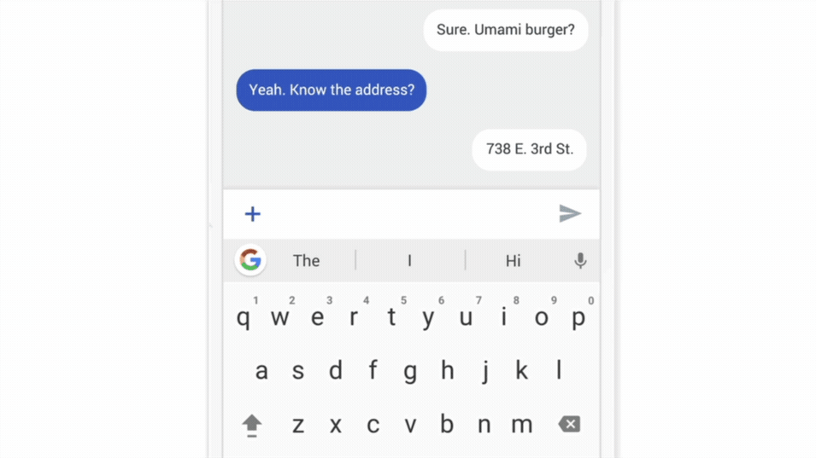
Federated Learning – Pros and Cons
Lower latency
More privacy-preserving
Less power consumption
Smarter models
Expensive communication
Privacy leakage
Highly heterogenous (non-IID) data
Device heterogeneity
B. McMahan, D. Ramage. Federated learning: Collaborative machine learning without centralized training data. Google AI. 2017.
Use case:
FedAvg: next word prediction in Google’s GBoard

Slide 5
Related Work
Survey Paper (Kairouz et al., 2019)
FedAvg (McMahan et al., 2016)
Non-IID Data (Smith et al., 2017; Karimireddy et al., 2019; Li et al., 2019; Mohri et al., 2019)
Local updates (Wang and Joshi, 2018; Koloskova et al., 2019)
Privacy and Security (Geyer et al., 2017; Agarwal et al., 2018; Bhowmick, Duchi et al., 2019; Li et al., 2019; Wang et al., 2020)
Compression methods (Konecny et al., 2016; Smith et al. 2017; Barnes, Han & Ozgur, 2019; Haddadpour et al., 2020)

Slide 6
Outline
Fast and Communication-Efficient Federated Learning
Quantization
Theoretical guarantees
Robust Federated Learning
Data Heterogeneity: Affine distribution shifts
Minimax optimization
FedPAQ: A Communication-Efficient Federated Learning Method with Period Averaging and Quantization
Resiziadeh, Mokhtari, Hassani, Jadbabaie, P (AISTATS 2020)
Robust Federated Learning: The Case of Affine Distribution Shifts
Resiziadeh, Farnia, P, Jadbabaie (NeurIPS 2020)

Slide 7
System Challenges in Federated Learning
Communication Load
In classical distributed ML, the updated models are sent to PS at each iteration.
Scalability issue
Device Heterogeneity (Stragglers)

Slide 8
Distributed SGD
SGD
SGD
SGD
SGD

Slide 9
FedAvg
SGD
SGD
SGD
SGD
….
….
….
….
SGD
SGD
SGD
SGD

Slide 10

FedPAQ
straggler
SGD
SGD
SGD
SGD
….
….
….
….
SGD
SGD
SGD
SGD

Slide 11
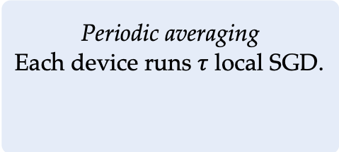
FedPAQ
FedPAQ is an iterative Federated Learning method and consists of three modules. In each round:
Periodic averaging
Each device runs $τ$ local SGD.
Model quantization
Uploads quantized updates.
Partial device participation
At each round, PS picks a fraction of devices.
Fewer communication rounds
Less privacy leakage
Less comm. overhead
Scalable
Device-Heterogeneity
Despite the noises and randomness, is FedPAQ provably converging?
If so, how fast?
What trade-offs does it provide?

Slide 12


Quantization Model
Example: Low-Precision quantizer [Alistarh et al., 2017]
randomly round up/down with $s$ levels
Properties of LP quantizer
unbiased
the variance grows with the $l_{2}$-norm

Slide 13
Theoretical Guarantees
Main problem
Assumptions:
A1. IID data uniformly across the devices.
A2. Smooth loss function.
ERM
A3. Unbiased and variance-bounded quantizer.
# of devices
# of samples per device
A4. Unbiased and variance-bounded stochastic gradients.
No gradient-bounded assumption!

Slide 14
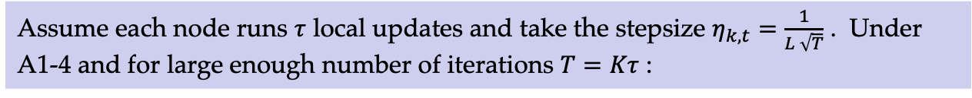
Theoretical Guarantees
Theorem 1: strongly convex loss
Assume each node runs $τ$ local updates and loss is $μ$-strongly convex. Take the stepsize $η_{k,t}=\frac{4/μ}{kτ+1}$ . Under A1-4 and for any $k≥k_{0}$:
All the constants depend only on the parameters.
Theorem 2: non-convex loss
Assume each node runs $τ$ local updates and take the stepsize $η_{k,t}=\frac{1}{L \sqrt{T}}$ . Under A1-4 and for large enough number of iterations $T=Kτ$ :
All the constants depend only on the parameters.

Slide 15

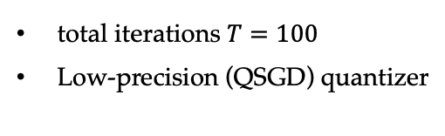
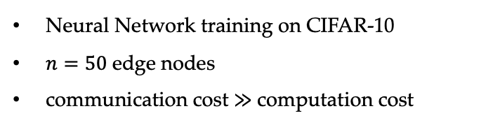
Numerical Results – Nonconvex case
For non-convex case:
less model accuracy
more computation
increasing $τ$
less communication rounds
less communication
Neural Network training on CIFAR-10
$n=50$ edge nodes
communication cost $≫$ computation cost
total iterations $T=100$
Low-precision (QSGD) quantizer

Slide 16
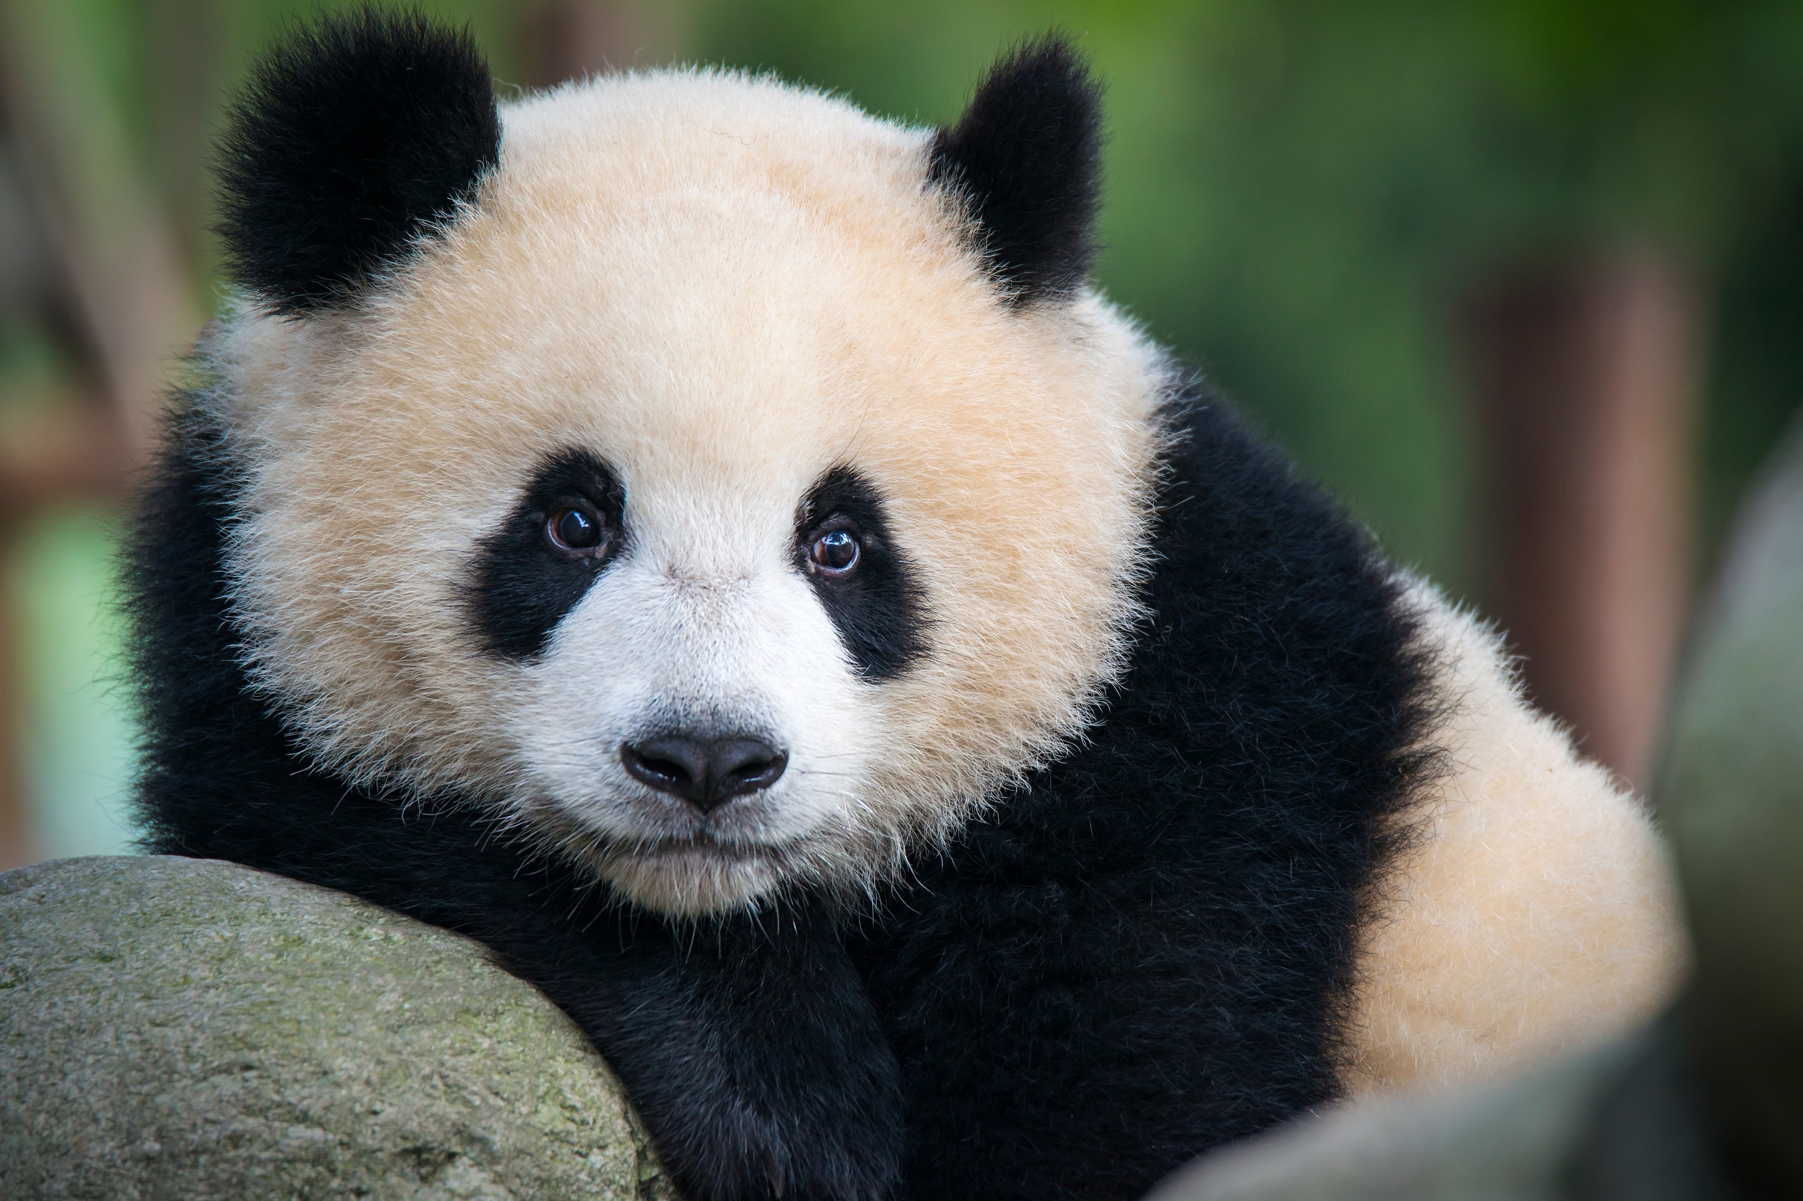
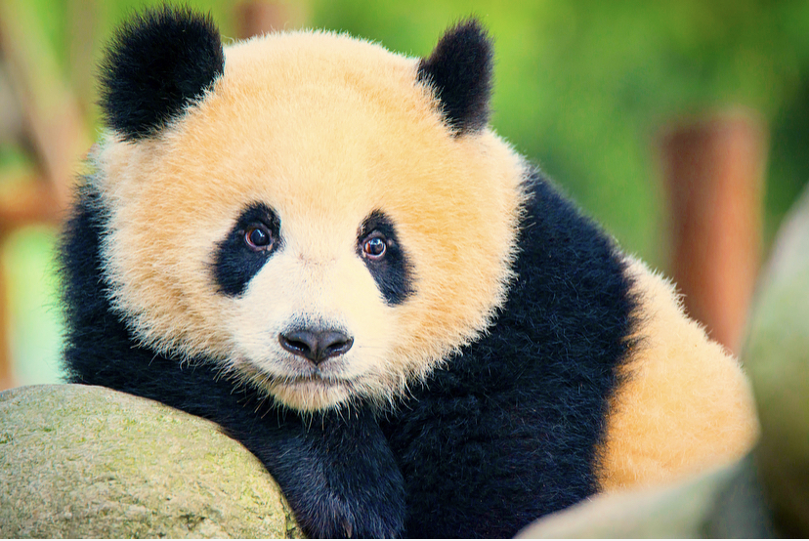
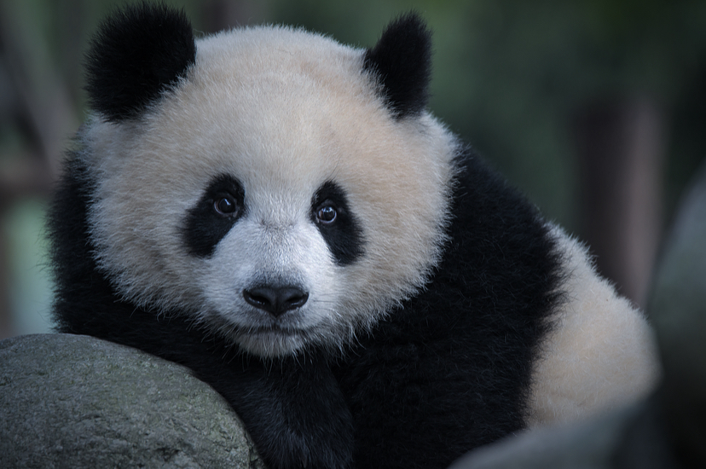
Data Heterogeneity
Challenge:
Data distributions vary across federated nodes (non-iid).
FedAvg fails with heterogenous data.
Observations:
Data heterogeneity in FL is device-dependent.
All the samples on a device undergo the same distortions (brightness, intensity, contrast).
device i
device j

Slide 17
Affine Transformation Model
Each sample stored in a node is distributed according to an affine transformation of a universal underlying distribution, i.e., transforming the features of a sample.
Universal adversarial perturbation per device
device i
device j

Slide 18
Minimax Optimization
Distributionally Robust Federated learning:
Find (worst case) affine transformations for each node.
avg loss over transformed data
global parameter
model
transformation variables
Constraints:
Need to be solved in a federated setting!
(Low computation and communication cost)

Slide 19
FL Framework Robust to Affine Distributed Shift
Local penalized loss
Global loss:
Robust FL framework

Slide 20
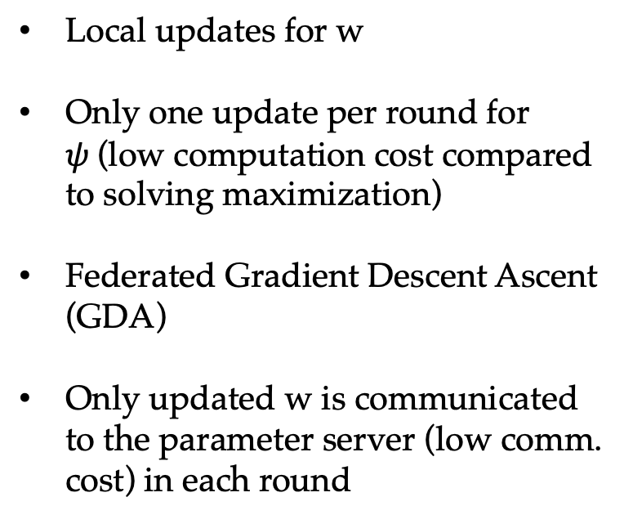
FedRobust Algorithm
Global loss
FedRobust
Local updates for w
Only one update per round for $ψ$(low computation cost compared to solving maximization)
Federated Gradient Descent Ascent (GDA)
Only updated w is communicated to the parameter server (low comm. cost) in each round
next round
local updates

Slide 21
Convergence of FedRobust
Assumptions:
A1. Bounded non-iid degree: Without perturbation, the variance of the local gradients with respect to the global gradient is bounded.
A2. Stochastic gradients: For node i, stochastic gradients and are unbiased and variance-bounded.
A3. All local loss functions have Lipschitz gradients.
A4. The global function f satisfies the two-sided PL condition:
(i)
(ii)

Slide 22
Convergence of FedRobust
To measure the optimality gap, define the potential function:
Theorem 1: PL-PL case
Consider the iterates of FedRobust. Under A1-4:
The case of regular non-federated distributed optimization i.e. when τ = 1, Theorem 1 recovers [Yang et al., 2020] for a minimax problem with PL-PL cost functions.
Putting ε1, ε2 → 0 reduces the problem to standard (non-robust) federated learning where our result recovers prior work [Haddadpour & Mahdavi, 2019].

Slide 23
FedRobust converges to stationary points for two classes of losses: PL-PL and Nonconvex-PL.
Convergence of FedRobust
Theorem 2: nonconvex-PL case
Consider the iterates of FedRobust. Under A1-4(ii):
FedRobust converges to a stationary point in the nonconvex-PL case.
Special cases: Recovers the result of distributed minimax optimization, i.e. τ = 1 [Lin, Jin & Jordan, 2019].
Recovers the result of standard federated learning for nonconvex objectives, i.e. when ε1, ε2 → 0 [Reisizadeh et al., 2019].
For spectrally regularized DNNs, we find a bound on the generalization error similar to [Farnia, Zhang & Tse, 2018].

Slide 24
FedRobust converges to stationary points for two classes of losses: PL-PL and Nonconvex-PL.
Numerical Setup
Tensor flow platform
Neural Networks with AlexNet, Inception-Net, and ResNet architectures.
10 nodes each with 5000 samples
Training samples are perturbed with random Gaussian vectors
Test samples are perturbed according to
Affine distribution shifts by optimizing inner maximization
Adversarial perturbations by PGD
Benchmarks: FedAvg, adversarial training by distributed fast gradient methods (FGM), [Goodfellow et al., 2014] and projected gradient descent (PGD), [Madry et al., 2017]

Slide 25
FedRobust converges to stationary points for two classes of losses: PL-PL and Nonconvex-PL.
Numerical Results
Affine distribution shifts:

Slide 26
FedRobust converges to stationary points for two classes of losses: PL-PL and Nonconvex-PL.
Numerical Results
Adversarial Perturbations:
FedRobust is 4x faster than adversarial training (low computation cost that is needed for federated setting).
Significantly improves over FedAvg.

Slide 27


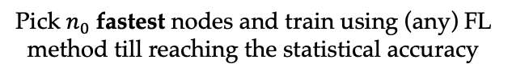



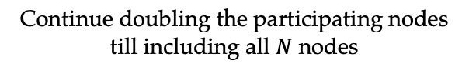
Ongoing Work – Device and Data Heterogeneity
fast
slow
$N$ heterogenous devices
Sort them from fastest to slowest
trained model $w_{n}^{⋆}$
initial model $w_{2n}^{0}=w_{n}^{⋆}$
fast
slow
fast
slow
Pick $n_{0}$fastest nodes and train using (any) FL method till reaching the statistical accuracy
Double the participating nodes and train with till reaching the statistical accuracy
…..
fast
slow
Continue doubling the participating nodes till including all $N$ nodes
Adaptive node size approach is able to speedup the FL algorithms by up to $log⁡(Ns)$ times.

Slide 28

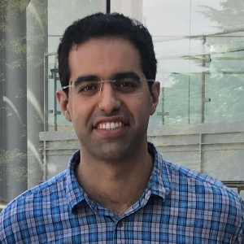

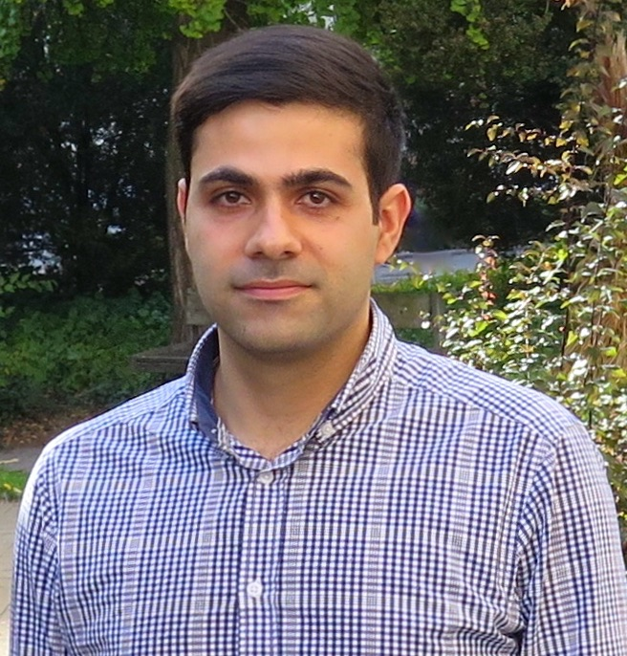
Conclusion and Future Directions
Fast and robust federated learning
FedPAQ
FedRobust
Future directions
Interplay of statistical accuracy and device heterogeneity
Privacy-preserving FL
Malicious nodes
General distribution shift
Personalized/Multitask learning
Amirhossein Reisizadeh
UCSB
Farzan Farnia
MIT
Aryan Mokhtari
UT Austin
Hamed Hassani
UPenn
Ali Jadbabaie
MIT

